Slide 1
Cyprus market plan
With questions/comments

Slide 2


Current situation in Cyprus
Good News
Cyprus densely populated with KFCs (1 KFC per 45,000 residents)
Consistent growth experienced YOY – build growth – sssg flat
Core population significantly supported by tourism
Not So Good
High degree of overlap with 8 minute drive time
Only 2 Drive Thru stores
Too early to market with delivery of KFC (rushed in to delivery of stores – inline assets instead of DT)
Running out of space for new builds
Stores fighting for same customers

Slide 3

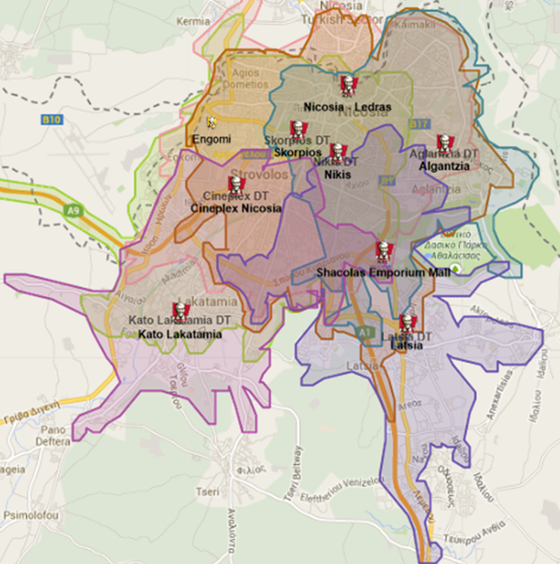

Illustration of 8 minute drive time
(uses google map drive time)
8 minute travel time catchment applied to each delivering store in Nicosia
Catchments differentiated by colour
Significant overlaps
Therefore, applying 8 minute drive time as criteria for determining trade zones is not possible.

Slide 4
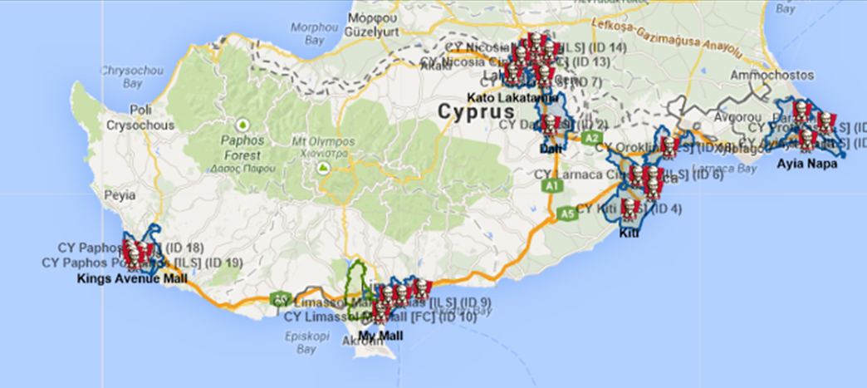
Cyprus market plan approach
Population target per store calculated
Catchments hand drawn
Drive time applied
Variance from target population calculated
Catchments adjusted as necessary

Slide 5
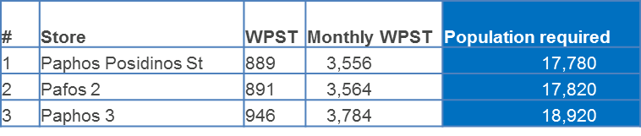
Target population per store
Deemed 20% of population in catchment required to meet monthly PST how did you get to this figure? And what population?
WPST obtained for each store (excluding malls as captive environment)
Monthly PST calculated
= WPST * 4
Target population per catchment calculated
= Monthly PST * 5
Assumptions
50000 households based on 1.8 people per household = 90000
Reduce to 80k as FC (which is captive)
This will equate to $26mm or 4000 trans per week
HOW DO we get to 20%
What other assumptions used to flex YRI 90k base?

Slide 6
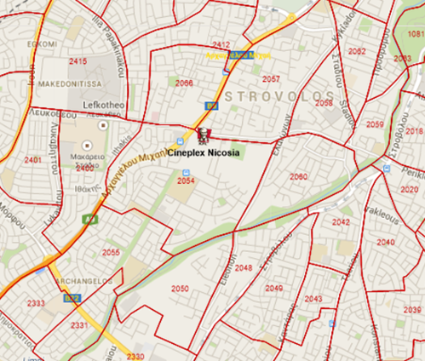
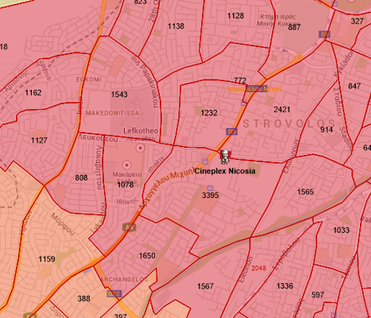
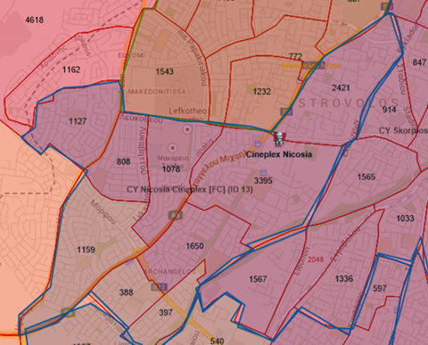

Catchments hand drawn
4 digit postcode layer turned on, illustrating postcode boundary and postcode name in centre.
Demographic layer on, demonstrating population density by colour & number.
→ The darker the shading; the higher the population density.
→ Population density indicated per postcode catchment.
Blue catchments hand drawn along postcode boundaries for all existing stores.
Each catchment given a unique ID, preceded by “CY” and indicating asset type.
E.g.
“CY Nicosia Cineplex [FC] (ID 13)

Slide 7
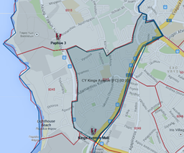
Catchments hand drawn - continued
Exception to the process above = All stores not delivering
Catchment hand drawn around postcode boundary in which store sits.
Catchments also captured within neighbouring store trade zone to eliminate risk of customers residing in an area not delivered to.
E.g.
Kings Avenue Mall within postcode catchment AND Paphos 3 catchment

Slide 8
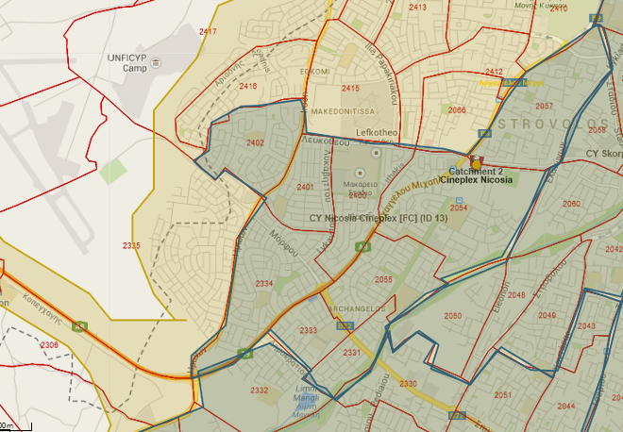
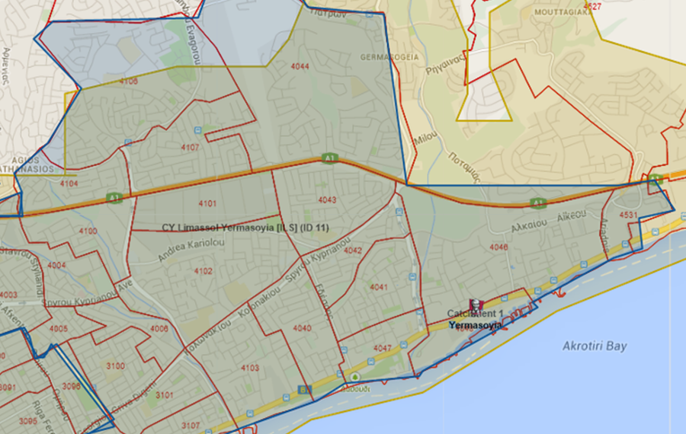
Drive time
Drive time of 8 minutes calculated from store location and compared to hand drawn trade zone.
Trade zone adjusted as necessary.
Travel time varied by region with significant overlaps in areas.
Key to examples below;
Blue = Hand drawn catchments
Yellow = 8 minute travel time
Red = postcode boundary
Example 1 – Cineplex Nicosia
Example 2 – Yermasoyia

Slide 9
Target population variance
Variance from target population per store calculated
(-ve = target population exceeded)
→Stores that do not deliver have been excluded from table below

Slide 10
Target population variance continued
Target exceeded = Safe
Target population exceeded therefore store considered to be safe.
Deficit < 10% = Balanced
Accepted variance.
Deficit > 10% = Risk
Stores requiring further investigation::
Larnaca Cineplex – captive environment as located in a cinema complex.
Larnaca
Oroklini
Ayia Napa
Protaras
Tourist arrivals in 2013:
Larnaca & Oroklini 280,610
Ayia Napa 433,670
Protaras & Paralimni 357,140
Source = Euromonitor
“Risk” stores accepted
All popular tourist destinations therefore customer base is not solely population.

Slide 11
Population obtained vs Drive time population
Current situation = 8 minute drive time catchments overlap and stores do not have clear delivery zones
Future with handdrawn TZ = Defined delivery areas for each store
Table below compares population per handdrawn TZ with population in current 8 minute drive time catchments per store, illustrating benefits of market plan for customer base per store.
Drive time population calculated as follows:
Population in 8 min drive time per store
number of stores per area
Avoid overlap of drive time catchments & duplication of population
Conclusion
Population obtained in hand drawn catchments exceeds drive time population by 104,000 residents overall.

Slide 12
Conclusion
Reactions
Do you feel aligned with the principles adopted on the market plan?
What concerns do you have now?
Moving forward
Output reports to be provided to you
Feedback within two weeks
Relevant adjustments made to trade zones
Confirm adoption of trade zones to lock in
Ongoing commitment to operating within defined boundaries
Questions for the future
Where is there space for more KFC stores in Cyprus?
Stores with depleted population/cause for concern – initiate discussions about different asset types

